Slide 1

Implementation of Transfer Learning with pre-trained Model for Pulmonary Image Classification
Neural Network
(22AI511T)
23mai007 –Tanmay Rathod

Slide 2
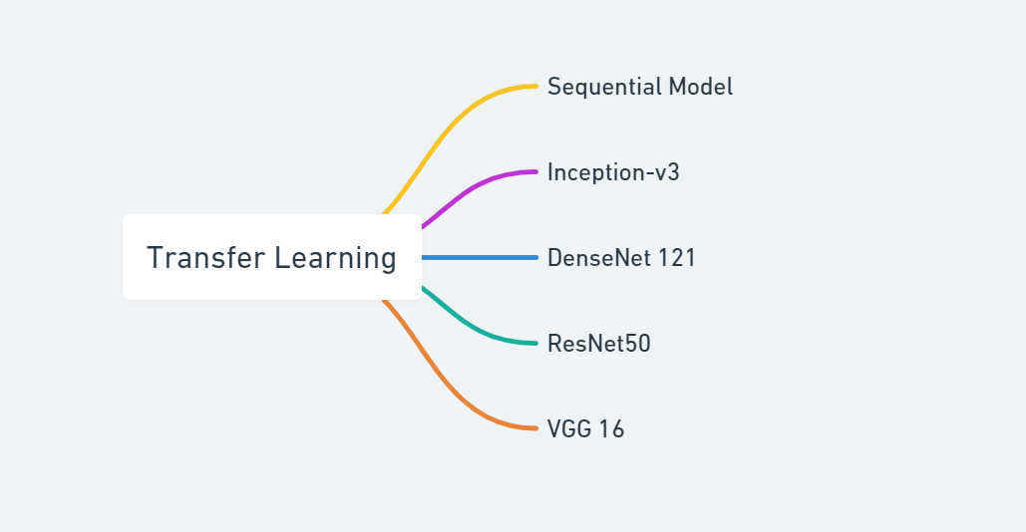

Slide 3
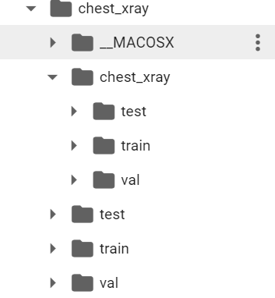
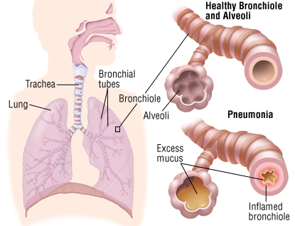
What is Pneumonia ?

Slide 4
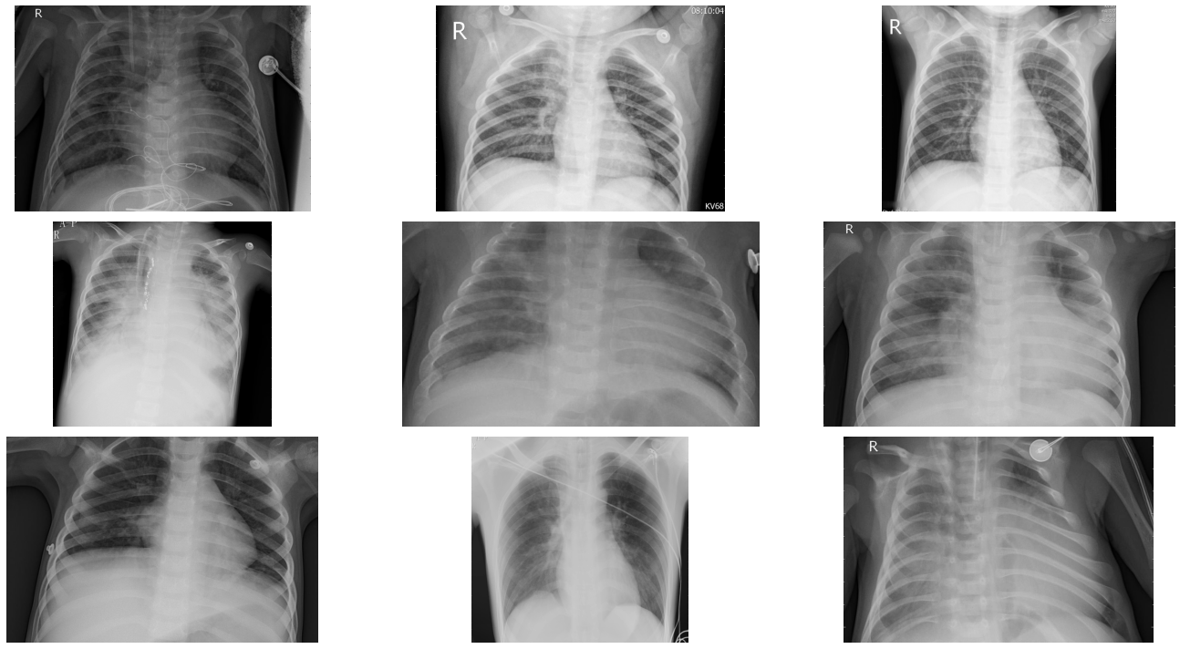
Data Visualization

Slide 5
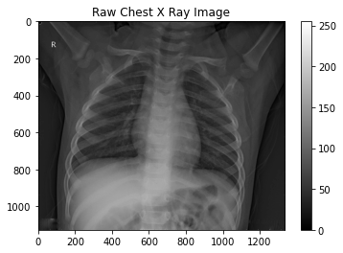
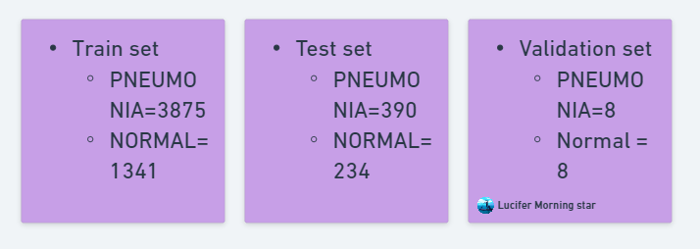
Datasets

Slide 6
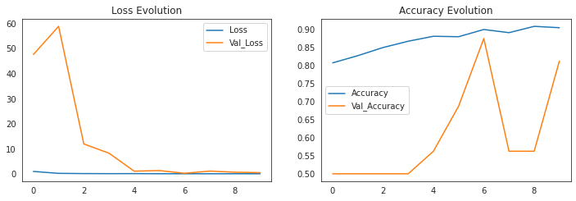
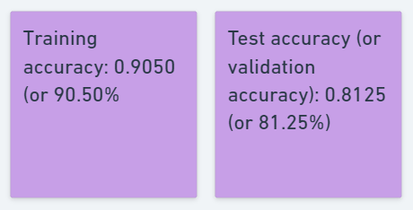
Sequential Model

Slide 7
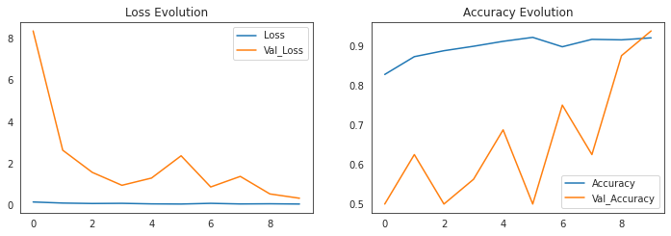
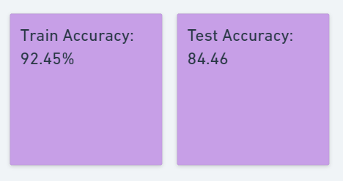
Dense Net 121

Slide 8
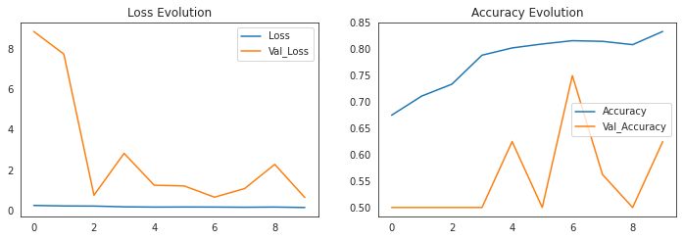
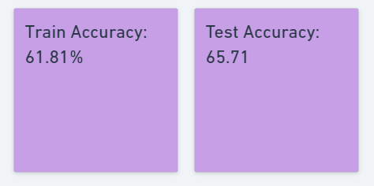
VGG 16

Slide 9
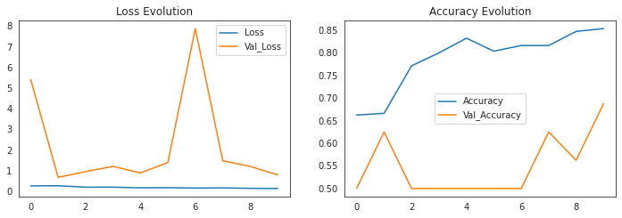
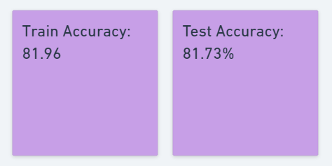
RSS Net

Slide 10
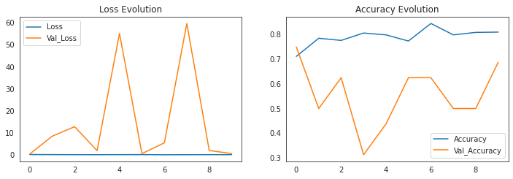
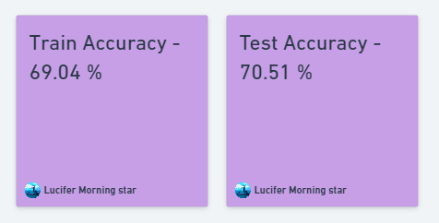
Inception – V3 Model

Slide 11

Reference
Chest X-Ray Images (Pneumonia) - https://www.kaggle.com/datasets/paultimothymooney/chest-xray-pneumonia/code?datasetId=17810&searchQuery=transfe
Medical Diagnosis with CNN& Transfer Learning –
https://www.kaggle.com/code/homayoonkhadivi/medical-diagnosis-with-cnn-transfer-learning
https://ieeexplore.ieee.org/abstract/document/8861312/
Git-Hub

Slide 12


